Slide 1

Faculty of Applied Engineering and Urban Planning
Civil Engineering Department
Dr. Eng. Mustafa Maher Al-tayeb
2 Semester 2022/2023
Probabilistic and Statistical

Slide 2
Chapter
Probability
4
(part
3)

Slide 3
Counting

Slide 4
Key Concept
In many probability problems, the big obstacle is
finding the
total
number
of
outcomes,
and
this
section presents several methods for
numbers without directly listing and possibilities.
finding such
counting the

Slide 5
Content
this section we will discuss the counting rule:
In
❖
❖
❖
❖
to
The
The
The
The
fundamental counting rule.
factorial rule.
permutations
permutations
rule (when
rule (when
items are all different).
some
items
are
identical
others).
❖ The combinations
rule.

Slide 6
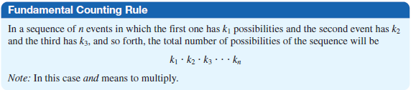
Fundamental
Counting
Rule

Slide 7
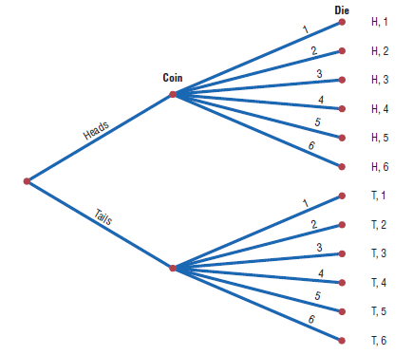
Ex. A coin is tossed and a die is
rolled.
Find
the
number
of
outcomes
for the sequence
of
events.
Solution:
2
6
12

Slide 8
Tree
Diagram
of
the
a b
events
T
T
T
T
T
F
F
F
F
F
&
&
&
&
&
&
&
&
&
&
a
b
c
d
e
a
b
c
d
e
T
c
d
e
a
b
c
d
e
F
2
5
10

Slide 9

Ex. There are four blood types, A, B, AB, and O. Blood
can also be Rh+ and Rh- . Finally, a blood donor can be
classified
ways can
as either male or female. How many
different
a
donor
have
his
or
her
blood
labeled?
Solution:

Slide 10
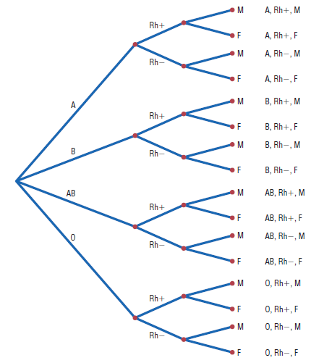

Slide 11
Factorial
Rule

Slide 12
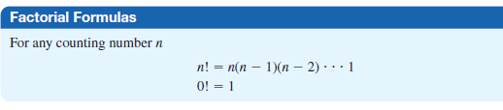
Factorial Rule
A collection of n different items can be arranged in order
n! different ways.
(This factorial rule reflects the fact that the first item may
be selected in n different ways, the
second
item
may
be
selected
in
n
–
1
ways,
and
so
on.)

Slide 13
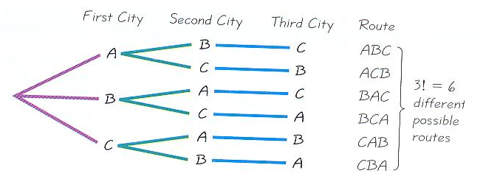
Probabilistic and Statistical Techniques
Routes to All 3 Capitals

Slide 14
Notation
The
factorial
symbol
!
denotes
the
product
of
decreasing positive whole
For example,
4!= 4×3× 2×1 = 24
numbers.
10! =10×9×8×7×6×5× 4×3× 2×1 =
By special definition, 0! = 1
3,628,800

Slide 15
For 3 letters:
There is 3! =6 Possible
arrangements
But if they are arranged in circular manner, just 2!= 2
a
ABC
ABC
ACB
BCA
arrangements
will appear.
BAC
CAB
BCA
ACB
A
CAB
BAC
CBA
CBA
C
B

Slide 16
Probabilistic and Statistical Techniques
Permutations Rule
(when items are all different)

Slide 17
Probabilistic and Statistical Techniques
Permutations Rule
(when items are all different)
Requirements:
There are n different items available. (This rule does not apply if some of the items are identical to others.)
We select r of the n items (without replacement).
We consider rearrangements of the same items to be different sequences. (The permutation of ABC is different from CBA and is counted separately.)
Then number of permutations (or sequences) of r items selected from n available items (without replacement) is
P
n!
n r
=
(n - r)!

Slide 18

Permutations Rule
(when
items
are
all
different)
^{P}r
n!
(n - r)!
n
=

Slide 19
Examples
Probabilistic and Statistical Techniques
Routes to 4 Capitals of the 50…(you do not have time to travel to 50 capitals, How many different routes are possible)
Novels of a n author…(you have to chose the best three novels (1 ,2, 3 ) of ten novels for prizes , How many different outcomes are possible)

Slide 20
Example
Probabilistic and Statistical Techniques
A horse race has 14 horses, how many different possible ways can the top 3 horses finish?
There are 14 possibilities for which horse finishes first, 13 for second, and 12 for third, so by the Fundamental Counting Principle, there are:
P
14!
14 3
=
(14 - 3)!
In the horse race example above we would write:

Slide 21

Ex.
A
radio
talk
show host can
select
3
of
6
special
guests
guests
done?
for her program. The order of appearance of the
is
important.
How
many
different
ways
can
this
be
Solution:

Slide 22

Ex. A school musical director can select 2 musical plays
to present next year. One will be presented in the fall, and
one will be presented in
the spring.
possibilities
If she has
9
to
pick
from, how
many
different
are
there?
Solution:

Slide 23
Permutations Rule
(when some items are identical
to
others)
Requirements:
1.
There are n items available, and some items
others.
are identical
to
2.
3.
We select all of the n items (without replacement).
We consider rearrangements of distinct items to be different sequences.

Slide 24
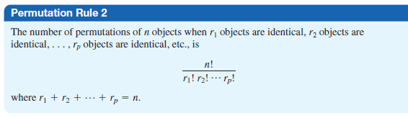
Permutations Rule
(when
some
items
are
identical
to
others)

Slide 25

Ex.1 How many permutations
of
the
letters
can
be
made
from the
word STATISTICS
?
Solution
:
Ex.2 Diet
and Regular Colas…(you
have 4 diet and 5
regular
colas
,
How
many
ways
can
we
arrange
the
letters DDDDRRRRR?)

Slide 26
Probabilistic and Statistical Techniques
Combinations Rule

Slide 27
Examples
Probabilistic and Statistical Techniques
Elected Offices…(From 9 members in the college, elect 3 persons committee to oversee buildings and grounds How many different 3 persons committee are possible)

Slide 28
Probabilistic and Statistical Techniques
Combinations Rule
Requirements:
There are n different items available.
We select r of the n items (without replacement).
We consider rearrangements of the same items to be the same. (The combination of ABC is the same as CBA.)
If the preceding requirements are satisfied, the number of combinations of r items selected from n different items is
n!
_{n}C_{r} =
(n - r )! r!

Slide 29


Ex.1 How many
2 at a time?
combinations
of
4
objects
are
there,
taken
Solution:
Ex.2
An
advertising
executive
must
select 3
different
different can she
photographs for an advertising flier. If she has 10
photographs that can be used, how many ways select 3 of them?
Solution:

Slide 30

Ex. In a club there are 7 women
and 5 men. A committee
of
3
women
and
2
men
is
to
be
chosen.
How
many
different possibilities
are
there?
Solution:

Slide 31
Probabilistic and Statistical Techniques
Comparison between Combinations Rule and Permutations Rule

Slide 32
Probabilistic and Statistical Techniques
Permutations versus Combinations
When different orderings of the same items are to be counted separately, we have a permutation problem,
but when different orderings are not to be counted separately, we have a combination problem.

Slide 33
Examples
Probabilistic and Statistical Techniques
Elected Offices…(From 9 members in the college, elect 3 persons committee to oversee buildings and grounds How many different 3 persons committee are possible)
Elected Offices…(From 9 members in the college, elect 3 persons, one is the chairperson, vice chairperson and secretary)

Slide 34
Possible permutations of three letters from the collection of five letters
Probabilistic and Statistical Techniques
Notes:
34

Slide 35
Probabilistic and Statistical Techniques
Possible Combinations of three letters from the collection of five letters
{a,b,c} {a,b,d} {a,b,e} {a,c,d} {a,c,e}
{a,d,e} {b,c,d} {b,c,e} {b,d,e} {c,d,e}
Notes:
35

Slide 36
Ex. In an experiment to test iron strengths, 3 different
ores,
4 different furnace
temperatures, and
2
different
cooling methods are to be considered. Altogether,
many experimental configurations are possible?
how
Solution :
The number
of experimental configurations is
3 × 4 × 2 = 24.

Slide 37
Ex. Twenty players compete in a tournament. In how many ways can
rankings be assigned to the top 5 competitors?
In how many ways can the best 5 competitors be chosen ( without
being in any
order)?
Solution:
The number
of rankings
P
that can be assigned to the top 5 competitors is
20!
20 5
=
(20 - 5)!
= 20 × 19 × 18 × 17 × 16 = 1,860,480.
The number of ways
in
which
the best 5
competitors can be chosen is
20!
- 5 )! 5!
20C5
=
= 15504.
(20

Slide 38
Ex. 1 In
a line ?
how
many
ways
can
six
people
sit
in
six
seats
in
Solution
6!
:
Ex.2 In how
many
ways
can
the
six
people
sit
around
a
dinner table eating
pizza ?
Solution:
5! ways

Slide 39
For 3 letters:
There is 3! =6 Possible
arrangements
But if they are arranged in circular manner, just 2!= 2
a
ABC
ABC
ACB
BCA
arrangements
will appear.
BAC
CAB
BCA
ACB
A
CAB
BAC
CBA
CBA
C
B

Slide 40
Ex.
A
box
contains
24 transistors,
4
find
of
which
are
defective.
If
4
are
sold
at
random,
the
following
probabilities.
a.
b. c. d.
Exactly 2
are defective.
All are defective.
None is
defective.
At
least
1
is
defective.

Slide 41




Solution:
a.
Exactly 2 are defective.
a.
All are defective.
a.
None is defective.
b.
At least 1 is defective.

